Slide 1
Analyzing Vigenere Vulnerabilities
Mario Enriquez
A00909441
COMP 7481

Slide 2
About the project
Vigenere is one of the classic Cryptography Ciphers
Choose to try and find vulnerabilities since I thought it was fairly secure cipher
Original plan was to choose biggest word in document to try and get the word from it
Discovered a there is a well documented Vigenere weakness

Slide 3
Vigenere Weakness
Repetition of character sequences can give the number of letters of the keyword based on distance
Babbage realized repetitions in the ciphertext indicated repetitions in the plaintext
Some of the most common words in English have pretty small number of letters e.g. the, and, that, for, of, to
If we add positioning and reverse cracking with these words we can get an idea of the keyword

Slide 4
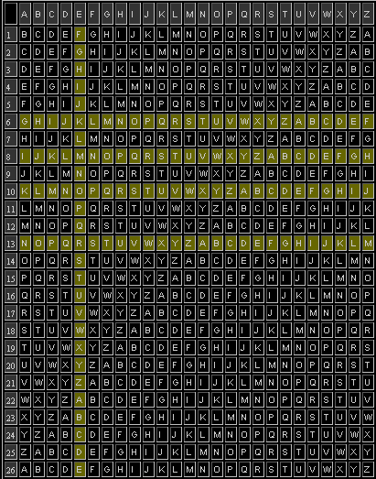


Slide 5
Frequency in English
Order Of Frequency Of Single Letters
Order Of Frequency Of Digraphs
Order Of Frequency Of Trigraphs
Order Of Frequency Of Most Common Doubles
Order Of Frequency Of Initial Letters
Order Of Frequency Of Final Letters
One-Letter Words
Most Frequent Two-Letter Words
Most Frequent Three-Letter Words
Most Frequent Four-Letter Words
E T A O I N S H R D L U
th er on an re he in ed nd ha at en es of or nt ea ti to it st io le is ou ar as de rt ve
the and tha ent ion tio for nde has nce edt tis oft sth men
ss ee tt ff ll mm oo
T O A W B C D S F M R H I Y E G L N P U J K
E S T D N R Y F L O G H A K M P U W
a, I.
of, to, in, it, is, be, as, at, so, we, he, by, or, on, do, if, me, my, up, an, go, no, us, am
the, and, for, are, but, not, you, all, any, can, had, her, was, one, our, out, day, get, has, him, his, how, man, new, now, old, see, two, way, who, boy, did, its, let, put, say, she, too, use
that, with, have, this, will, your, from, they, know, want, been, good, much, some, time

Slide 6
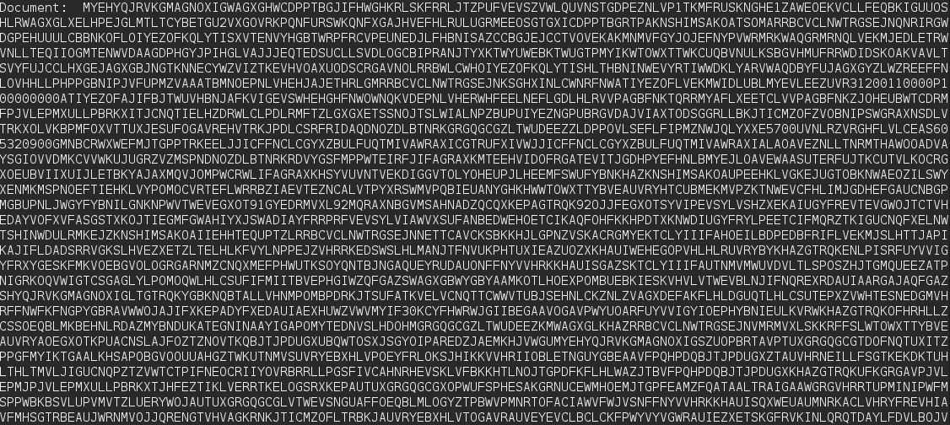
The experiment
For the experiment I created a python program that would analyze a document that was encrypted with a keyword that I provided
I would select a sequence of three characters and search iterations of it in the document
Get the factors to obtain the presumed key length

Slide 7
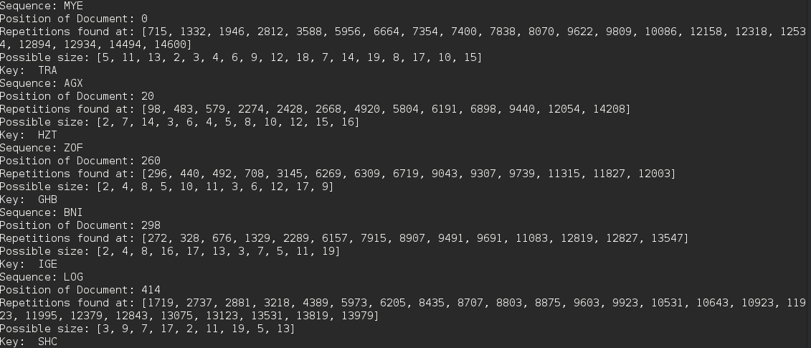
Additionally we can try reverse obtaining one of the most common three letter words which is THE
With the position and subsequent analysis we could obtain the possible length

Slide 8
Conclusions from this experiment
The longer and varied character the key has, more difficult is to find it as it leads to less repetitions
Encrypting the ciphertext again with a different keyword can decrease chances of obtaining plaintext. Obviously the main problem with this method is that you require more keys
The shorter the document is it’s more difficult to find it since not many words are used
Keeping the document format along with punctuations make it easier to decipher

Slide 9
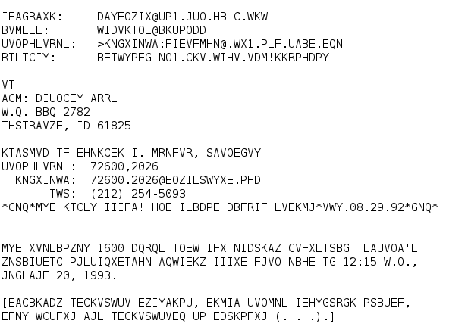
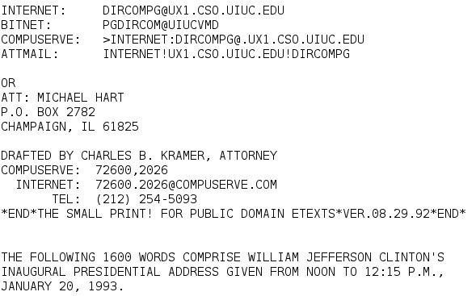

Slide 10
Q & A

Slide 11
References
https://www3.nd.edu/~busiforc/handouts/cryptography/cryptography%20hints.html
http://www.simonsingh.net/The_Black_Chamber/vigenere_cracking_tool.html

